Slide 1
Last Time
Geometric continuity
Parametric surfaces
  General Tensor product surfaces
  Bezier surfaces
4/29/04
© University of Wisconsin, CS559 Spring 2004

Slide 2
Today
BSplines
4/29/04
© University of Wisconsin, CS559 Spring 2004

Slide 3
B-splines
B-splines automatically take care of continuity, with exactly one control vertex per curve segment
Many types of B-splines: degree may be different (linear, quadratic, cubic,…) and they may be uniform or non-uniform
  We will only look closely at uniform B-splines
With uniform B-splines, continuity is always one degree lower than the degree of each curve piece
  Linear B-splines have C⁰ continuity, cubic have C², etc
4/29/04
© University of Wisconsin, CS559 Spring 2004

Slide 4
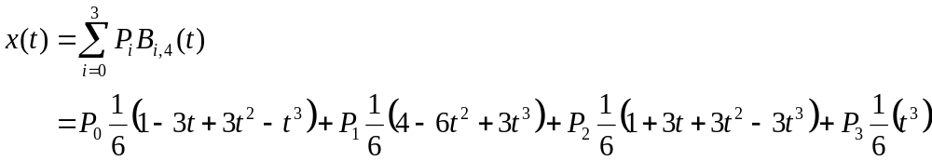
Uniform Cubic B-spline on [0,1)
Four control points are required to define the curve for 0≤t<1 (t is the parameter)
  Not surprising for a cubic curve with 4 degrees of freedom
The equation looks just like a Bezier curve, but with different basis functions
  Also called blending functions - they describe how to blend the control points to make the curve
4/29/04
© University of Wisconsin, CS559 Spring 2004

Slide 5
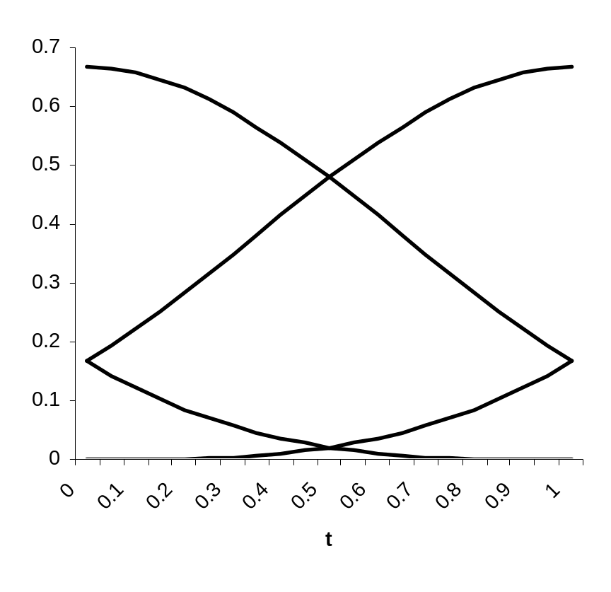
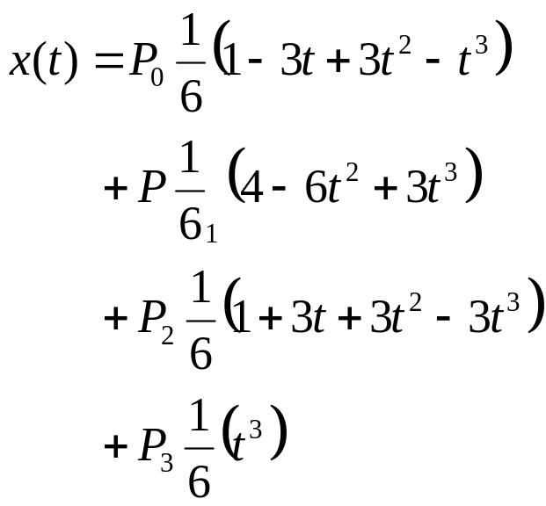
Basis Functions on [0,1)
Does the curve interpolate its endpoints?
Does it lie inside its convex hull?
B_{1,4}
B_{2,4}
B_{0,4}
B_{3,4}
4/29/04
© University of Wisconsin, CS559 Spring 2004

Slide 6
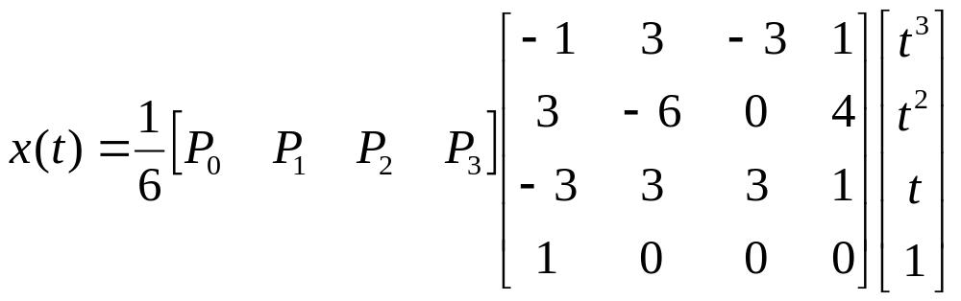
Uniform Cubic B-spline on [0,1)
The blending functions sum to one, and are positive everywhere
  The curve lies inside its convex hull
The curve does not interpolate its endpoints
  Requires hacks or non-uniform B-splines
There is also a matrix form for the curve:
4/29/04
© University of Wisconsin, CS559 Spring 2004

Slide 7
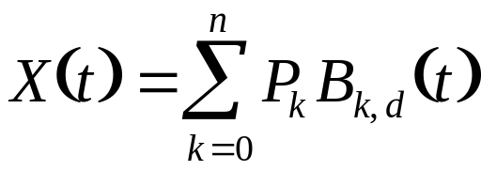
Uniform Cubic B-splines on [0,m)
Curve:
  n is the total number of control points
  d is the order of the curves, 2 ≤ d ≤ n+1, d typically 3 or 4
  B_{k,d} are the uniform B-spline blending functions of degree d-1
  P_{k} are the control points
  Each B_{k,d} is only non-zero for a small range of t values, so the curve has local control
4/29/04
© University of Wisconsin, CS559 Spring 2004

Slide 8
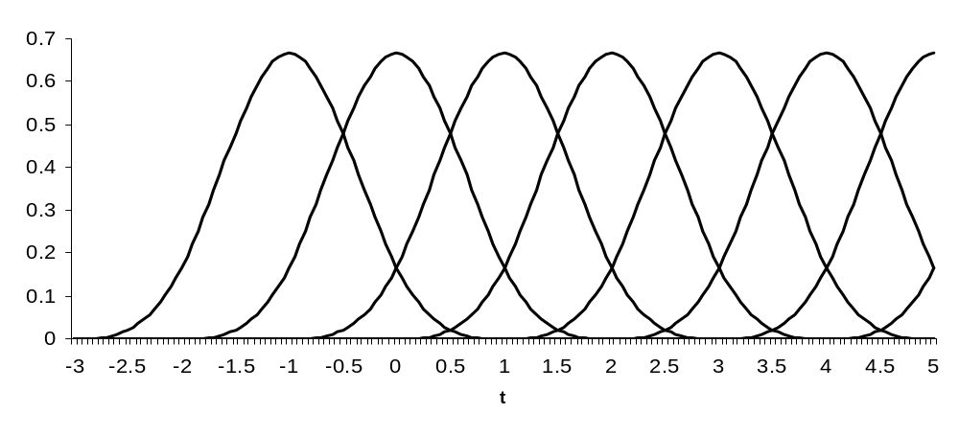
Uniform Cubic B-spline Blending Functions
B_{0,4}
B_{1,4}
B_{2,4}
B_{3,4}
B_{4,4}
B_{5,4}
B_{6,4}
4/29/04
© University of Wisconsin, CS559 Spring 2004

Slide 9
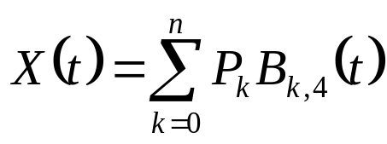
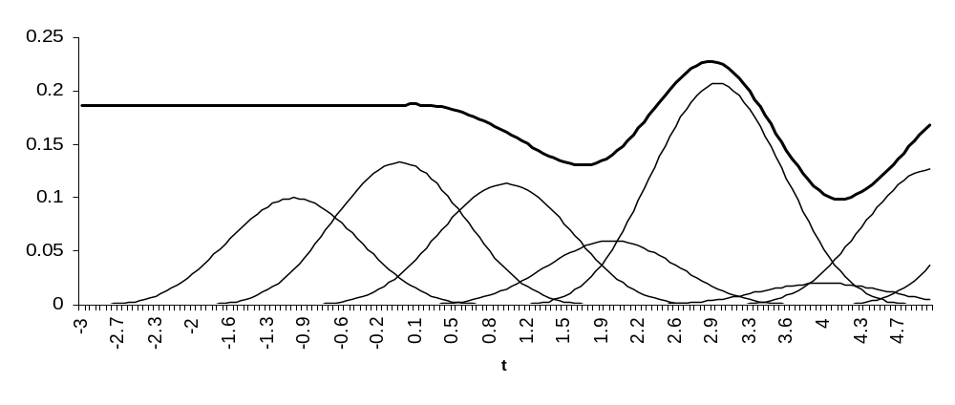
Computing the Curve
P₁B_{1,4}
P₄B_{4,4}
P₀B_{0,4}
P₂B_{2,4}
P₆B_{6,4}
P₃B_{3,4}
P₅B_{5,4}
The curve can’t start until there are 4 basis functions active
4/29/04
© University of Wisconsin, CS559 Spring 2004

Slide 10
Using Uniform B-splines
At any point t along a piecewise uniform cubic B-spline, there are four non-zero blending functions
Each of these blending functions is a translation of B_{0,4}
Consider the interval 0≤t<1
  We pick up the 4th section of B_{0,4}
  We pick up the 3rd section of B_{1,4}
  We pick up the 2nd section of B_{2,4}
  We pick up the 1st section of B_{3,4}
4/29/04
© University of Wisconsin, CS559 Spring 2004

Slide 11
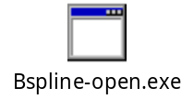
Demo
4/29/04
© University of Wisconsin, CS559 Spring 2004

Slide 12
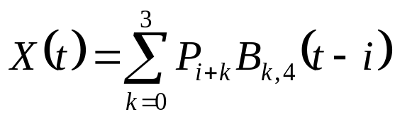
Uniform B-spline at Arbitrary t
The interval from an integer parameter value i to i+1 is essentially the same as the interval from 0 to 1
  The parameter value is offset by i
  A different set of control points is needed
To evaluate a uniform cubic B-spline at an arbitrary parameter value t:
  Find the greatest integer less than or equal to t: i = floor(t)
  Evaluate:
Valid parameter range: 0≤t<n-3, where n is the number of control points
4/29/04
© University of Wisconsin, CS559 Spring 2004

Slide 13
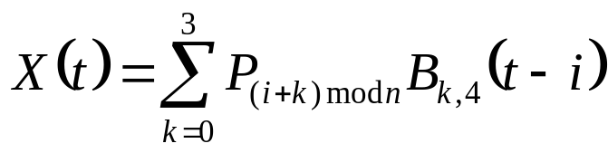
Loops
To create a loop, use control points from the start of the curve when computing values at the end of the curve:
Any parameter value is now valid
  Although for numerical reasons it is sensible to keep it within a small multiple of n
4/29/04
© University of Wisconsin, CS559 Spring 2004

Slide 14
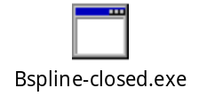
Demo
4/29/04
© University of Wisconsin, CS559 Spring 2004

Slide 15
B-splines and Interpolation, Continuity
Uniform B-splines do not interpolate control points, unless:
  You repeat a control point three times
  But then all derivatives also vanish (=0) at that point
  To do interpolation with non-zero derivatives you must use non-uniform B-splines with repeated knots
To align tangents, use double control vertices
  Then tangent aligns similar to Bezier curve
Uniform B-splines are automatically C²
  All the blending functions are C², so sum of blending functions is C²
  Provides an alternate way to define blending functions
  To reduce continuity, must use non-uniform B-splines with repeated knots
4/29/04
© University of Wisconsin, CS559 Spring 2004

Slide 16
Rendering B-splines
Same basic options as for Bezier curves
  Evaluate at a set of parameter values and join with lines
    Hard to know where to evaluate, and how pts to use
  Use a subdivision rule to break the curve into small pieces, and then join control points
    What is the subdivision rule for B-splines?
Instead of subdivision, view splitting as refinement:
  Inserting additional control points, and knots, between the existing points
  Useful not just for rendering - also a user interface tool
  Defined for uniform and non-uniform B-splines by the Oslo algorithm
4/29/04
© University of Wisconsin, CS559 Spring 2004

Slide 17
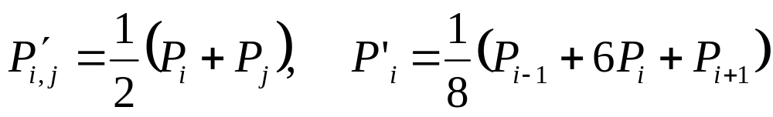
Refining Uniform Cubic B-splines
Basic idea: Generate 2n-3 new control points:
  Add a new control point in the middle of each curve segment: P’_{0,1}, P’_{1,2}, P’_{2,3} , …, P’_{n-2,n-1}
  Modify existing control points: P’₁, P’₂, …, P’_{n-2}
    Throw away the first and last control
Rules:
If the curve is a loop, generate 2n new control points by averaging across the loop
When drawing, don’t draw the control polygon, join the x(i) points
4/29/04
© University of Wisconsin, CS559 Spring 2004

Slide 18
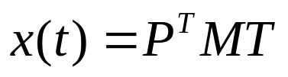
From B-spline to Bezier
Both B-spline and Bezier curves represent cubic curves, so either can be used to go from one to the other
Recall, a point on the curve can be represented by a matrix equation:
  P is the column vector of control points
  M depends on the representation: M_{B-spline} and M_{Bezier}
  T is the column vector containing: t³, t², t, 1
By equating points generated by each representation, we can find a matrix M_{B-spline->Bezier} that converts B-spline control points into Bezier control points
4/29/04
© University of Wisconsin, CS559 Spring 2004

Slide 19
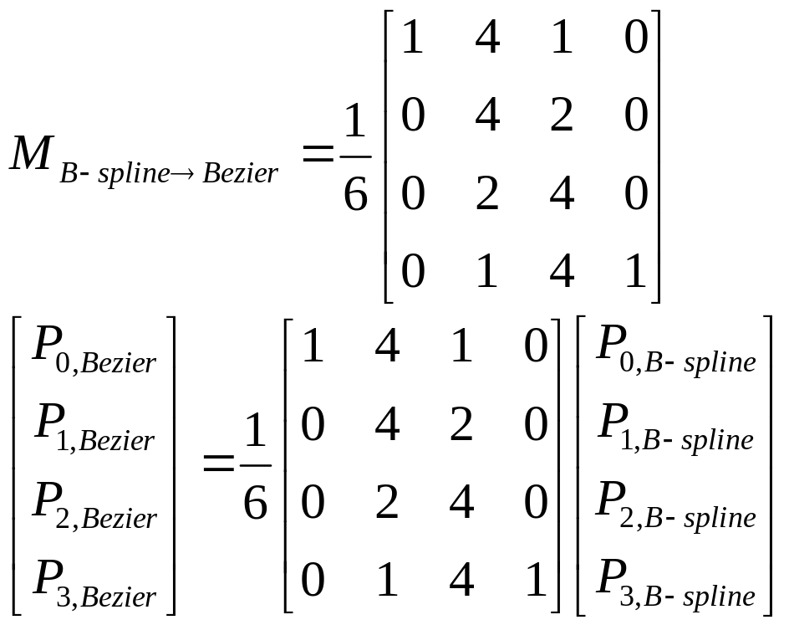
B-spline to Bezier Matrix
4/29/04
© University of Wisconsin, CS559 Spring 2004

Slide 20
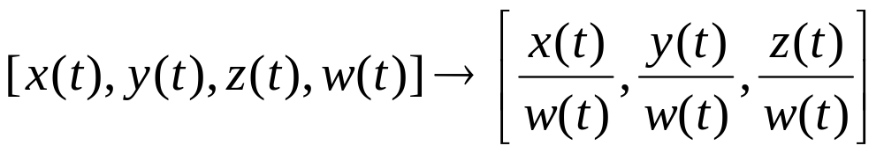
Rational Curves
Each point is the ratio of two curves
  Just like homogeneous coordinates:
  NURBS: x(t), y(t), z(t) and w(t) are non-uniform B-splines
Advantages:
  Perspective invariant, so can be evaluated in screen space
  Can perfectly represent conic sections: circles, ellipses, etc
    Piecewise cubic curves cannot do this
4/29/04
© University of Wisconsin, CS559 Spring 2004

Slide 21
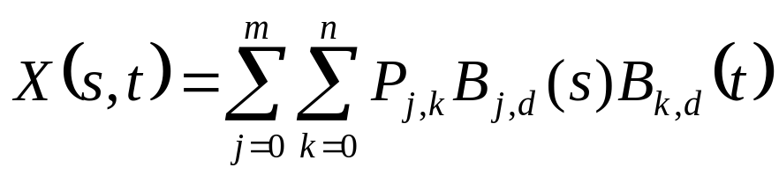
B-Spline Surfaces
Defined just like Bezier surfaces:
Continuity is automatically obtained everywhere
BUT, the control points must be in a rectangular grid
OK
Not OK
4/29/04
© University of Wisconsin, CS559 Spring 2004

Slide 22
Non-Uniform B-Splines
Uniform B-splines are a special case of B-splines
Each blending function is the same
A blending functions starts at t=-3, t=-2, t=-1,…
Each blending function is non-zero for 4 units of the parameter
Non-uniform B-splines can have blending functions starting and stopping anywhere, and the blending functions are not all the same
4/29/04
© University of Wisconsin, CS559 Spring 2004

Slide 23
B-Spline Knot Vectors
Knots: Define a sequence of parameter values at which the blending functions will be switched on and off
Knot values are increasing, and there are n+d+1 of them, forming a knot vector: (t₀,t₁,…,t_{n+d}) with t₀ ≤ t₁ ≤ … ≤ t_{n+d}
Curve only defined for parameter values between t_{d-1} and t_{n+1}
These parameter values correspond to the places where the pieces of the curve meet
There is one control point for each value in the knot vector
The blending functions are recursively defined in terms of the knots and the curve degree
4/29/04
© University of Wisconsin, CS559 Spring 2004

Slide 24
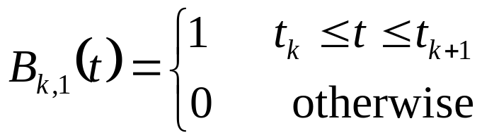
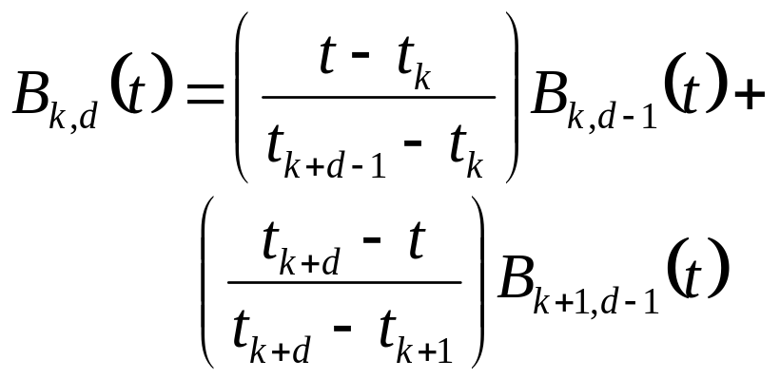
B-Spline Blending Functions
The recurrence relation starts with the 1st order B-splines, just boxes, and builds up successively higher orders
This algorithm is the Cox - de Boor algorithm
  Carl de Boor was a professor here
4/29/04
© University of Wisconsin, CS559 Spring 2004

Slide 25
Uniform Cubic B-splines
Uniform cubic B-splines arise when the knot vector is of the form (-3,-2,-1,0,1,…,n+1)
Each blending function is non-zero over a parameter interval of length 4
All of the blending functions are translations of each other
  Each is shifted one unit across from the previous one
  B_{k,d}(t)=B_{k+1,d}(t+1)
The blending functions are the result of convolving a box with itself d times, although we will not use this fact
4/29/04
© University of Wisconsin, CS559 Spring 2004

Slide 26
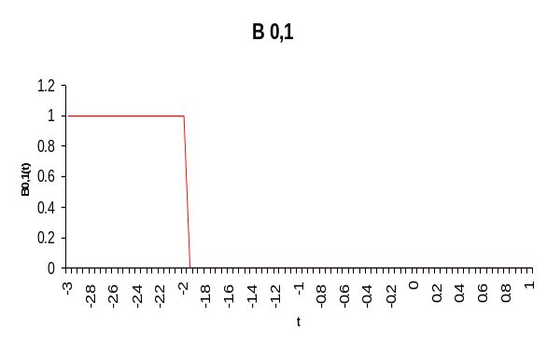
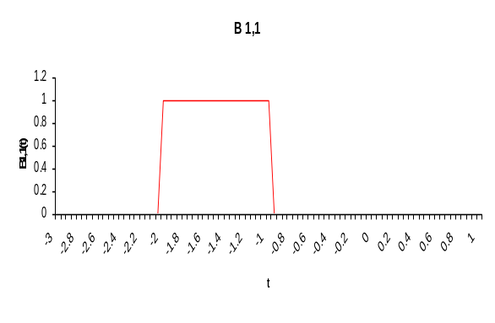
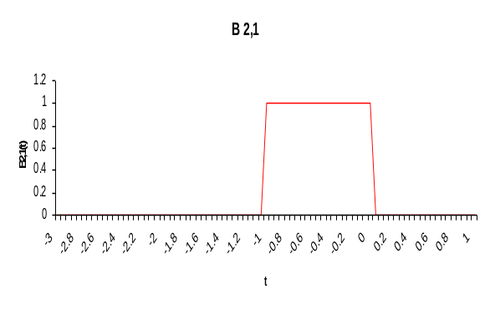
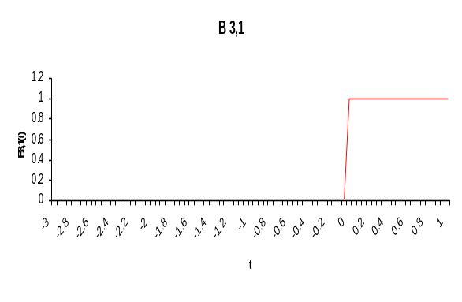
B_{k,1}
4/29/04
© University of Wisconsin, CS559 Spring 2004

Slide 27
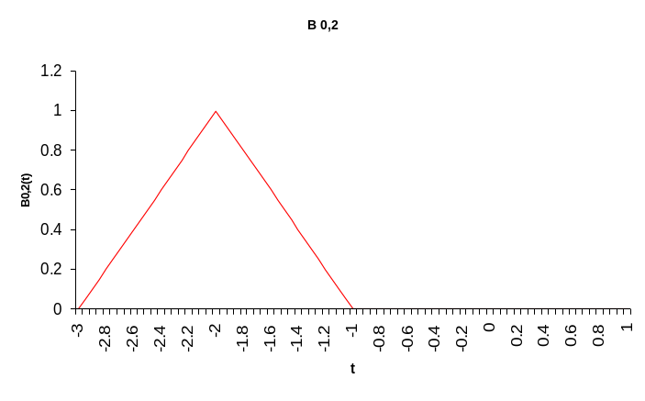
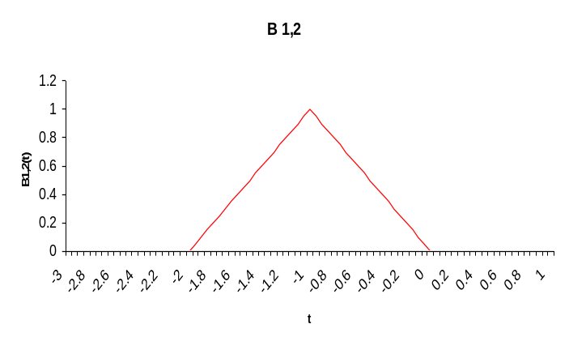
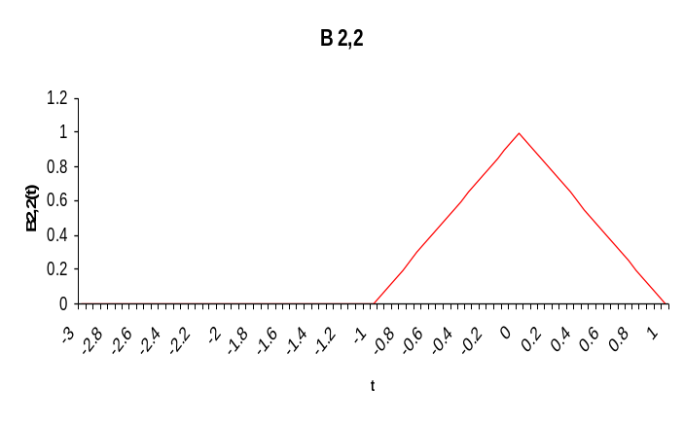
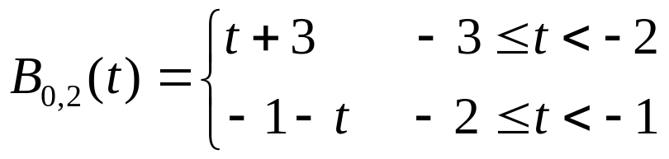
B_{k,2}
4/29/04
© University of Wisconsin, CS559 Spring 2004

Slide 28
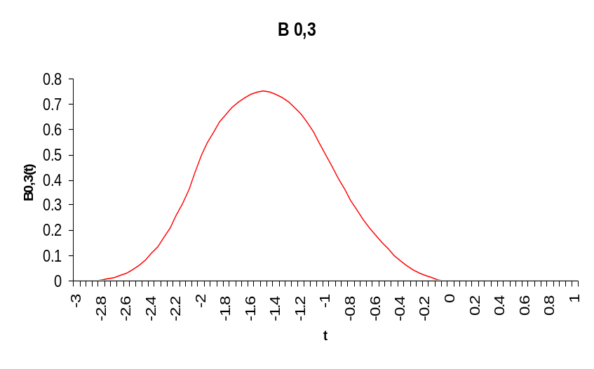
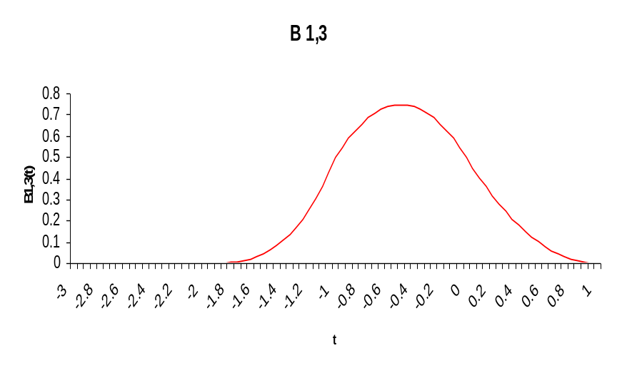
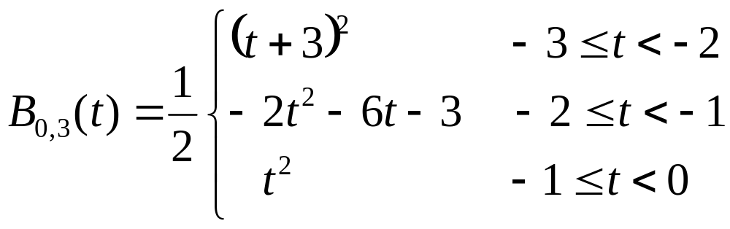
B_{k,3}
4/29/04
© University of Wisconsin, CS559 Spring 2004

Slide 29
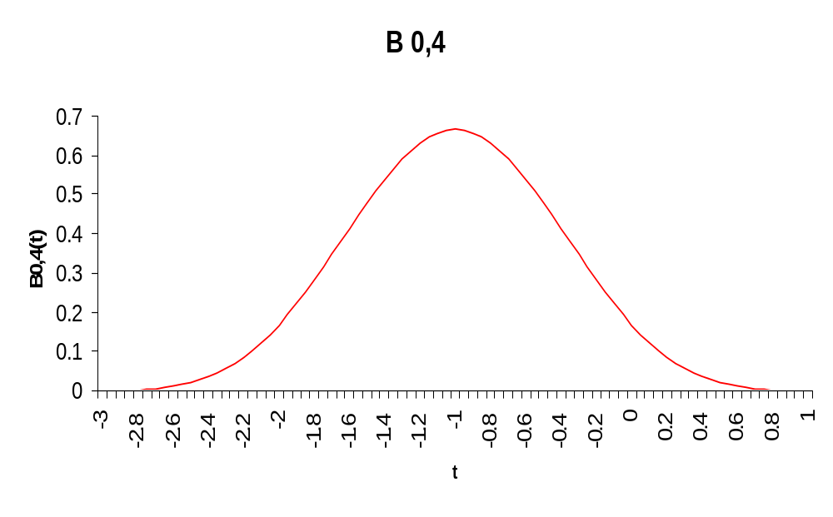
B_{0,4}
4/29/04
© University of Wisconsin, CS559 Spring 2004

Slide 30
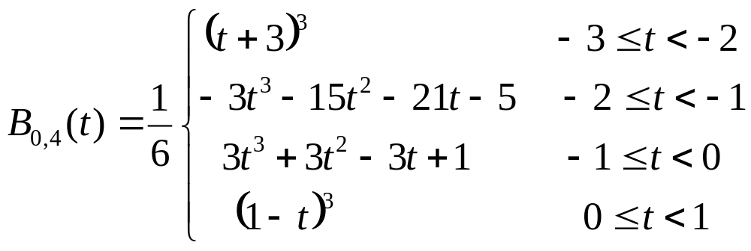
B_{0,4}
Note that the functions given on slides 4 and 5 are translates of this function obtained by using (t-1), (t-2) and (t-3) instead of just t, and then selecting only a sub-range of t values for each function
4/29/04
© University of Wisconsin, CS559 Spring 2004

Slide 31
Interpolation and Continuity
The knot vector gives a user control over interpolation and continuity
If the first knot is repeated three times, the curve will interpolate the control point for that knot
  Repeated knot example: (-3,-3,-3, -2, -1, 0, …)
  If a knot is repeated, so is the corresponding control point
If an interior knot is repeated, continuity at that point goes down by 1
Interior points can be interpolated by repeating interior knots
A deep investigation of B-splines is beyond the scope of this class
4/29/04
© University of Wisconsin, CS559 Spring 2004

Slide 32
How to Choose a Spline
Hermite curves are good for single segments where you know the parametric derivative or want easy control of it
Bezier curves are good for single segments or patches where a user controls the points
B-splines are good for large continuous curves and surfaces
NURBS are the most general, and are good when that generality is useful, or when conic sections must be accurately represented (CAD)
4/29/04
© University of Wisconsin, CS559 Spring 2004

